Slide 1
Postman API TESTING
Workshop Week Presentation April 10 2025

Slide 2


The TEAM!!

Slide 3

What is Postman?
Content:
Postman is a platform for building, testing, and documenting APIs.
Use Cases:
Backend testing during API development
Quality Assurance testing before software release
Monitoring APIs in production

Slide 4
Introduction to API Testing
API testing ensures that the backend services of an ERP system function correctly.
It validates request-response mechanisms, data integrity, and business logic.
API Testing Helps detect issues early in the development cycle.

Slide 5

Why API Testing Matters
APIs are the glue between systems (mobile apps, web services, databases).
Without API testing :
Bugs go undetected until it’s too late
Integration issues cost time and money
Security vulnerabilities remain hidden

Slide 6
What use Postman?
User-friendly interface for making API requests.
Supports REST APIs.
Features automated testing, and collections .
Enables efficient debugging and monitoring of API responses.

Slide 7

Where Does Postman fit in the Software Lifecycle??
Postman is used during multiple stages of the software development lifecycle:
Development: Developers test endpoints as they build them.
Testing: QA teams automate and validate responses.
Deployment: DevOps teams should use it in CI/CD pipelines.
Monitoring: Teams use Postman monitors for uptime and reliability.
EVERY STEP OF THE WAY!!

Slide 8

Setting Up Postman
1. Download
2. New Workspace
3. Get Host URL
Download and install Postman from postman.com. Follow the Instructions to Setup Postman.
Open a new workspace for HTTP requests to allow for ERP API testing.
See where the backend is deployed to allow for API request calls.
Don’t Worry!!! We'll show you how it's done!

Slide 9
Key API Testing Methods in Postman
GET: Retrieve data from the ERP system (e.g., fetch product list).
POST: Send data to create new entries (e.g., add a new supplier).
PUT: Update existing records (e.g., modify employee details).
DELETE: Remove records (e.g., delete a warehouse entry).

Slide 10


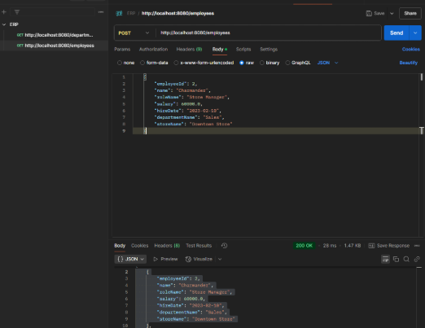

Testing PgSQL Backend with Postman
Database Connection
Tested CRUD Operations on Tables
This ensured that the backend API connected to the database correctly
Verified CRUD operations on the tables and checked the response codes outputted. (200 OK, 400 Bad Request, etc.).

Slide 11

LAB 2: Performance Tests

Slide 12
Test Type | Users | Response Time (ms) | Throughput (req/sec) | Error Rate (%) | CPU/Memory Usage
Load Test | 500 | 230 | 29.3 | 0.00 | 69%, 73%
Stress Test | 5000 | 799 | 53.7 | 0.12 | 95%, 93%
Spike Test | 50→1000 | 334 | 22.4 | 0.02 | 75%, 88%
Endurance Test | 200 | 235 | 456.5 | 0.05 | 55%, 65%
Scalability Test | 100→1000 | 306 | 15.5 | 0.00 | 77, 72
Volume Test | 800 | 275 | 45.5 | 0.00 | 64%, 61%

Slide 13
🧠 Critical Analysis & Key Insights
1. Load Test (Stable Performance) ✅
Response time (230ms) is fast for 500 users.
No errors, and moderate resource usage.
Indicates G9G handles expected traffic levels well.
2. Stress Test (System Strain Detected) 🚨
At 5000 users, response time spikes to 799ms.
Error rate increases to 0.12%, and CPU/memory nearly maxed (95%, 93%).
Suggests performance bottlenecks under extreme loads — potential for DoS risk if unoptimised.
3. Spike Test (Sudden Traffic Bursts) ⚡
Simulates sudden user surge (50→1000).
System recovers well with only 334ms response and 0.02% error rate.
Suggests auto-scaling or caching mechanisms might be helping.
This actually happened!!

Slide 14
🧠 Critical Analysis & Key Insights
4. Endurance Test (Long-Session Stability) 🕒
Maintains low response time (235ms) even over time.
Impressive throughput (456.5 req/s), indicating robust long-term handling.
Low resource drain shows solid memory management.
5. Scalability Test (System Growth) 📈
As user count increases, throughput remains lower (15.5 req/s) — may reflect backend database or threading limits.
6. Volume Test (High Data Flow) 📦
At 800 concurrent users, system performs well (275ms, 0% error).
Shows strong handling of bulk requests — perfect for G9G’s game loads/pages.

Slide 15
SECTION 2: Workshop (Get your hands ready)

Slide 16
🔧 Installing Postman
Go to https://www.postman.com/downloads/
Support both desktop and web versions (in case someone can’t install).

Slide 17
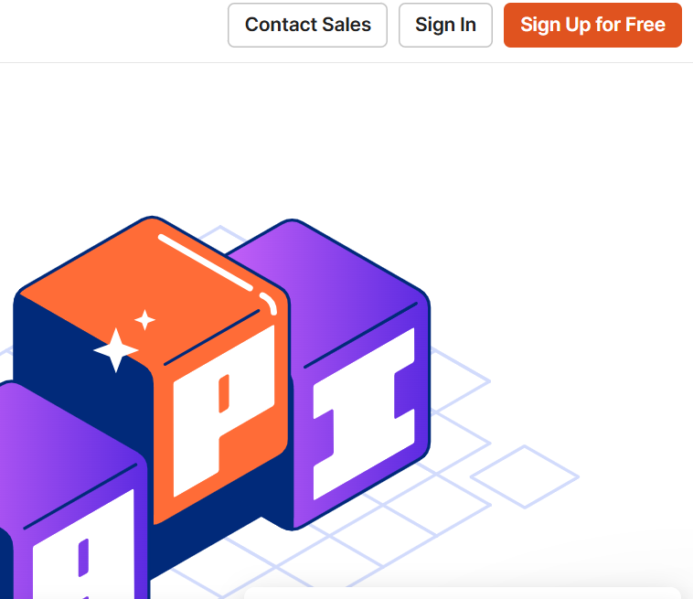
🔧 Sign Up
Sign Up or Log in if you have an existing account

Slide 18
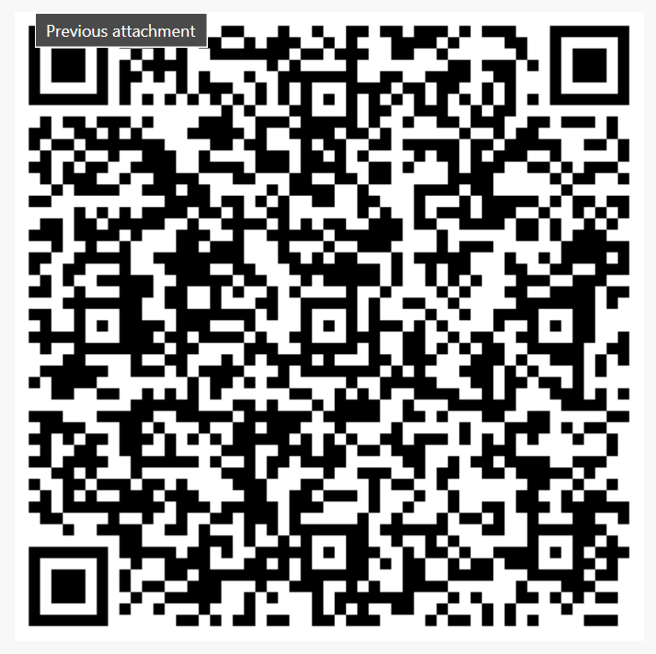
💬 Discussion Questions
What was your first impression of the tool?
Can you think of real projects where this would be useful?
Any ideas for improving how we test APIs?

